Slide 1
Assignment #2: Accelerator beam position monitoring data – big data solution
Carl Wilson U0370630

Slide 2
Aims and objectives
AIM:
Develop a “big data solution” to determine faulty sensor readings in the CERN “Accelerator Beam Position Monitoring Data”.
OBJECTIVES:
Explore the data structure and complete statistical analysis examining outliers on a sample of the dataset [~2-3%].
Develop a prototype algorithm and perform initial tuning of hyperparameters on a sample of the dataset [~10%].
Verify prototype hyperparameters on ~20% of the dataset.
Apply the prototype algorithm and hyperparameters to a “Big Data Solution” using Spark and conduct outlier analysis on the full dataset.
Validation of “Big Data Solution” when scaling to full dataset.

Slide 3
1] Exploratory data analysis: statistical analysis
CERN Beam Position Monitor Data

Slide 4
Data structure
33 Experiments
536 Sensors
X-Axis
536 Sensors
Y-Axis
6600 Turns
6600 Turns
Data structure:
33 Experiments
2 Axes Monitored
536 Sensors per Axes
6600 Turns per Sensor
A total of 233,481,600 datapoints
Potential features:
Axes
Sensor number
Experiment [category]
Turn / measurement
Data is received in 66 individual files, one per axis and experiment.

Slide 5
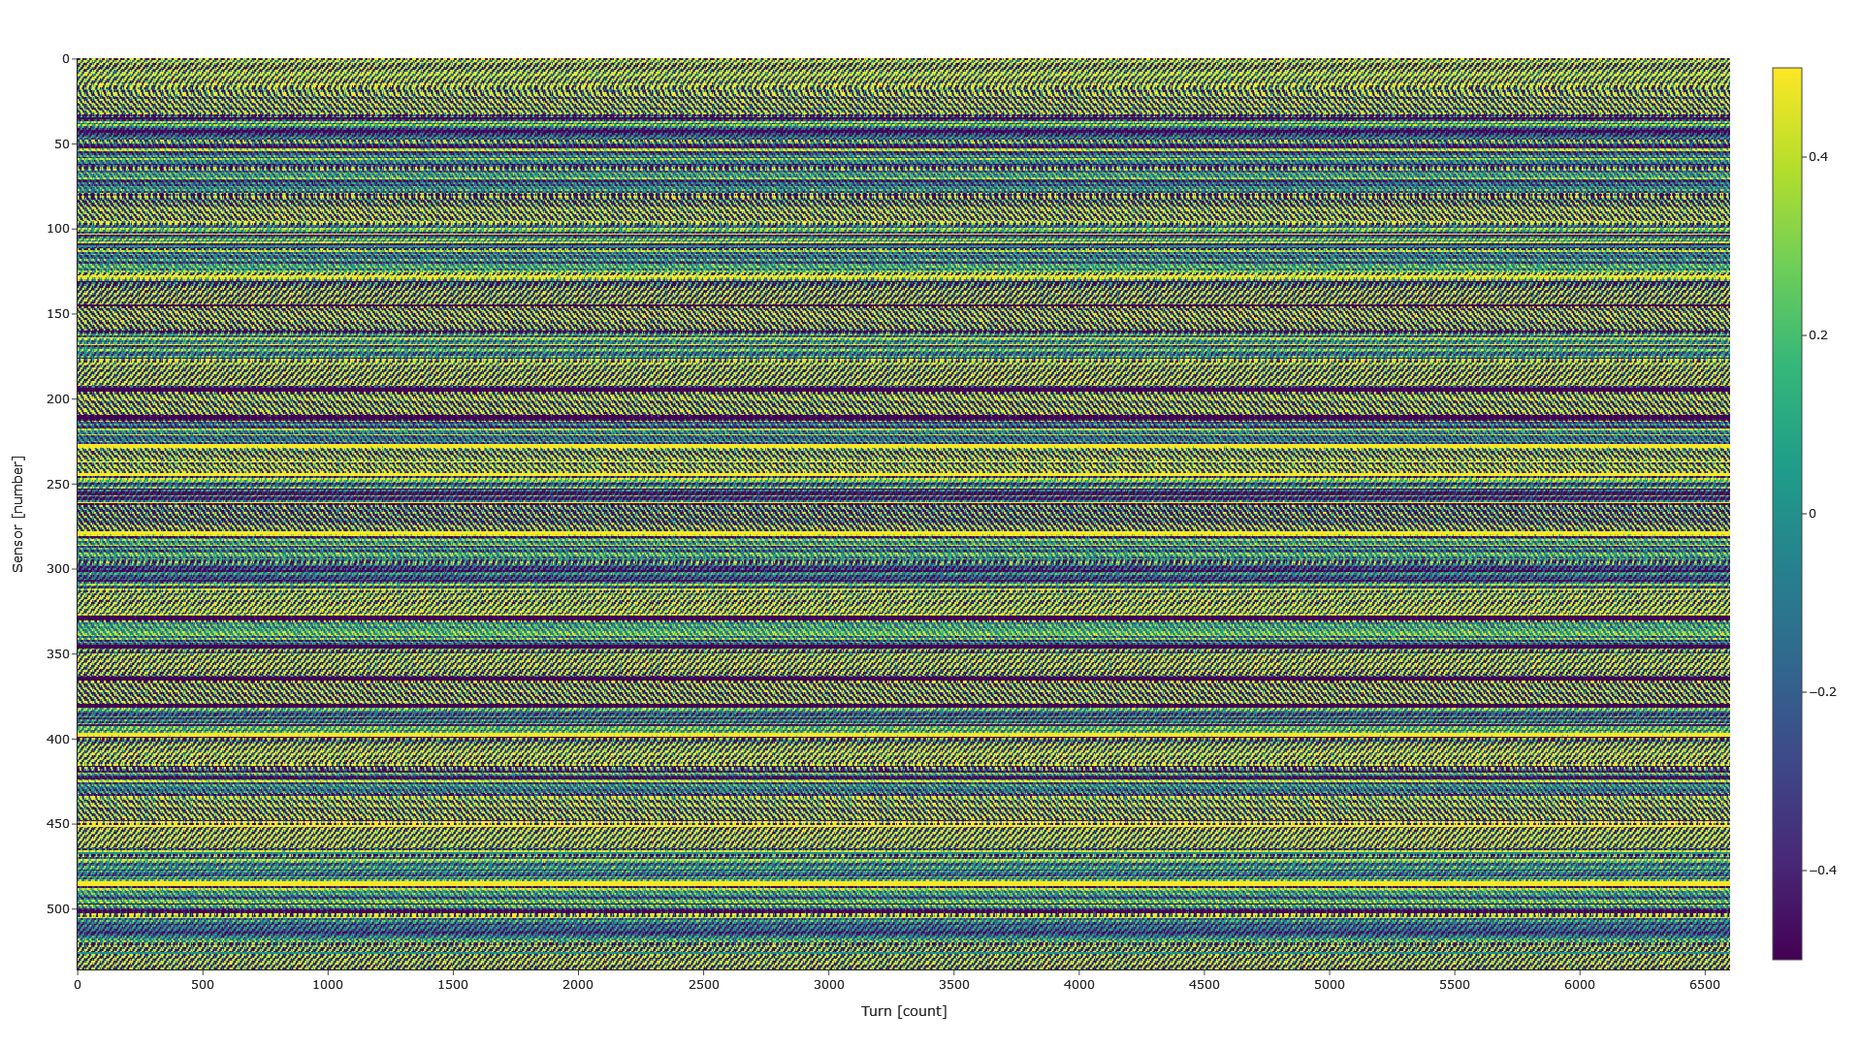
Heatmap [+/-0.5]: Beam1@Turn@2018_05_29@17_48_36_697X
Distinct solid bands out of range for some sensors
Distinct geometric patterns of in/out range on other sensors

Slide 6
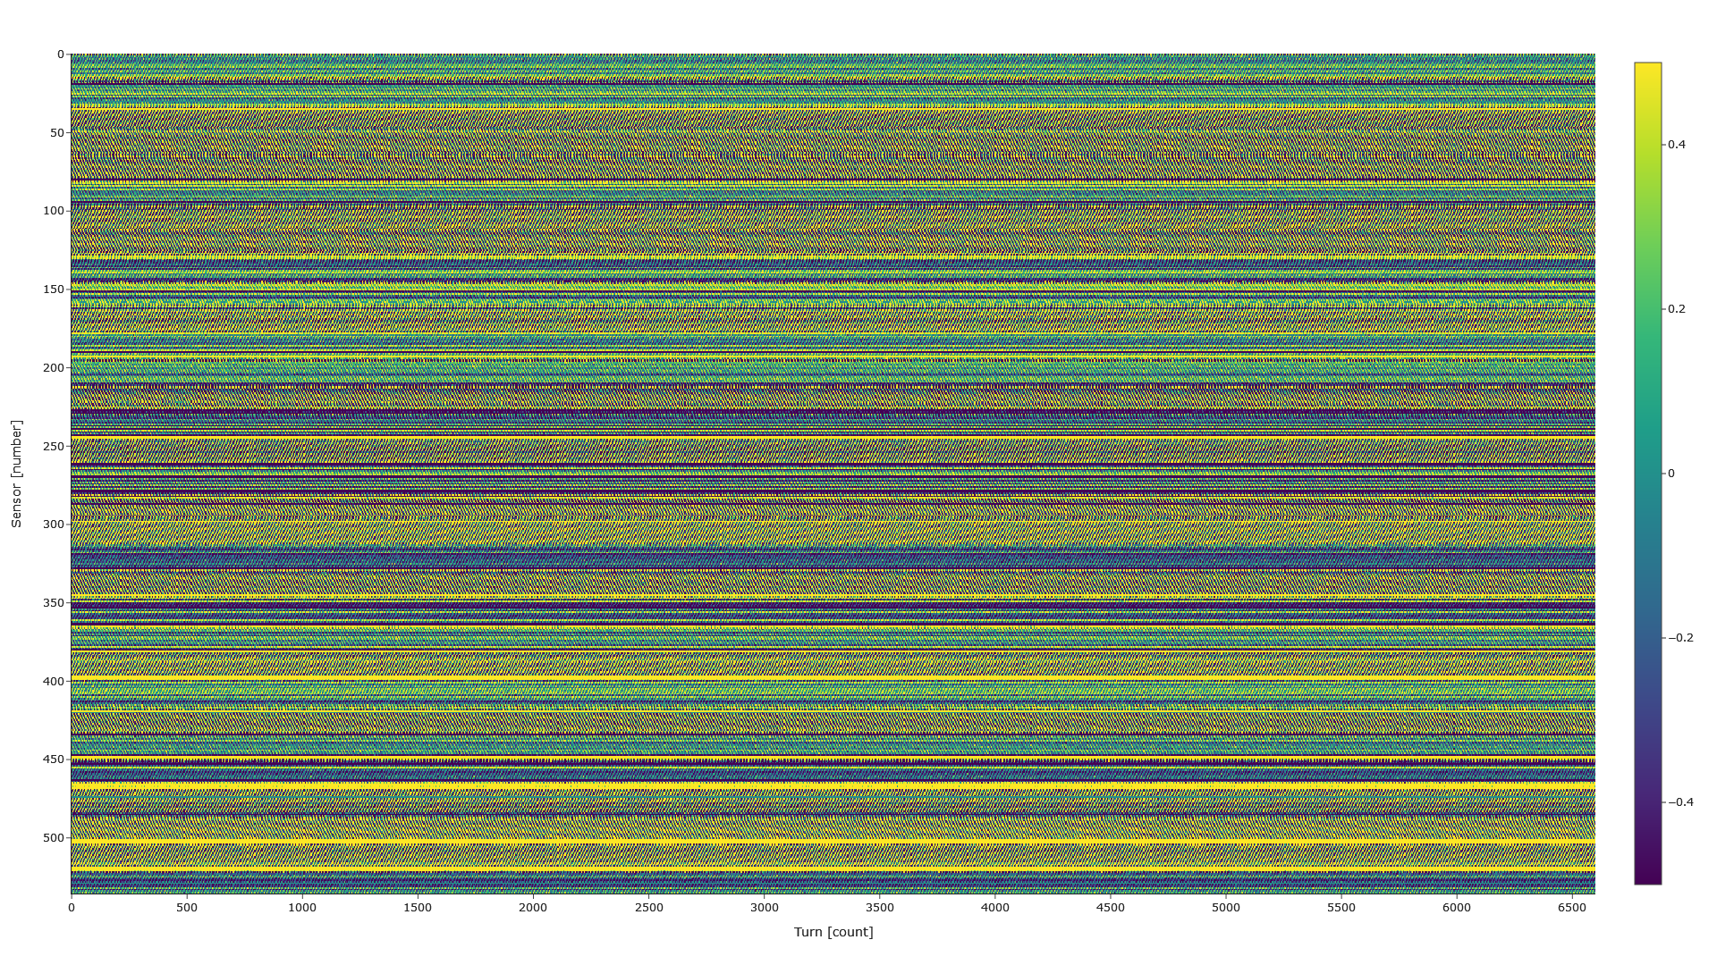
Heatmap [+/-0.5]: Beam1@Turn@2018_05_29@17_48_36_697Y
Very similar patterns and bands on the Y axis also

Slide 7
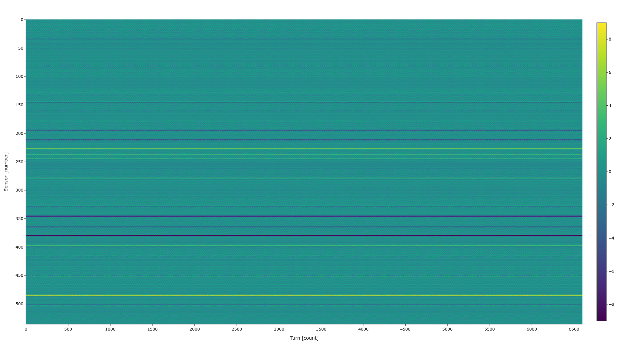
Heatmap [+/-9]: Beam1@Turn@2018_05_29@17_48_36_697X
Solid dark blue and bright yellow lines indicate sensor readings at the extreme or outside of the range

Slide 8
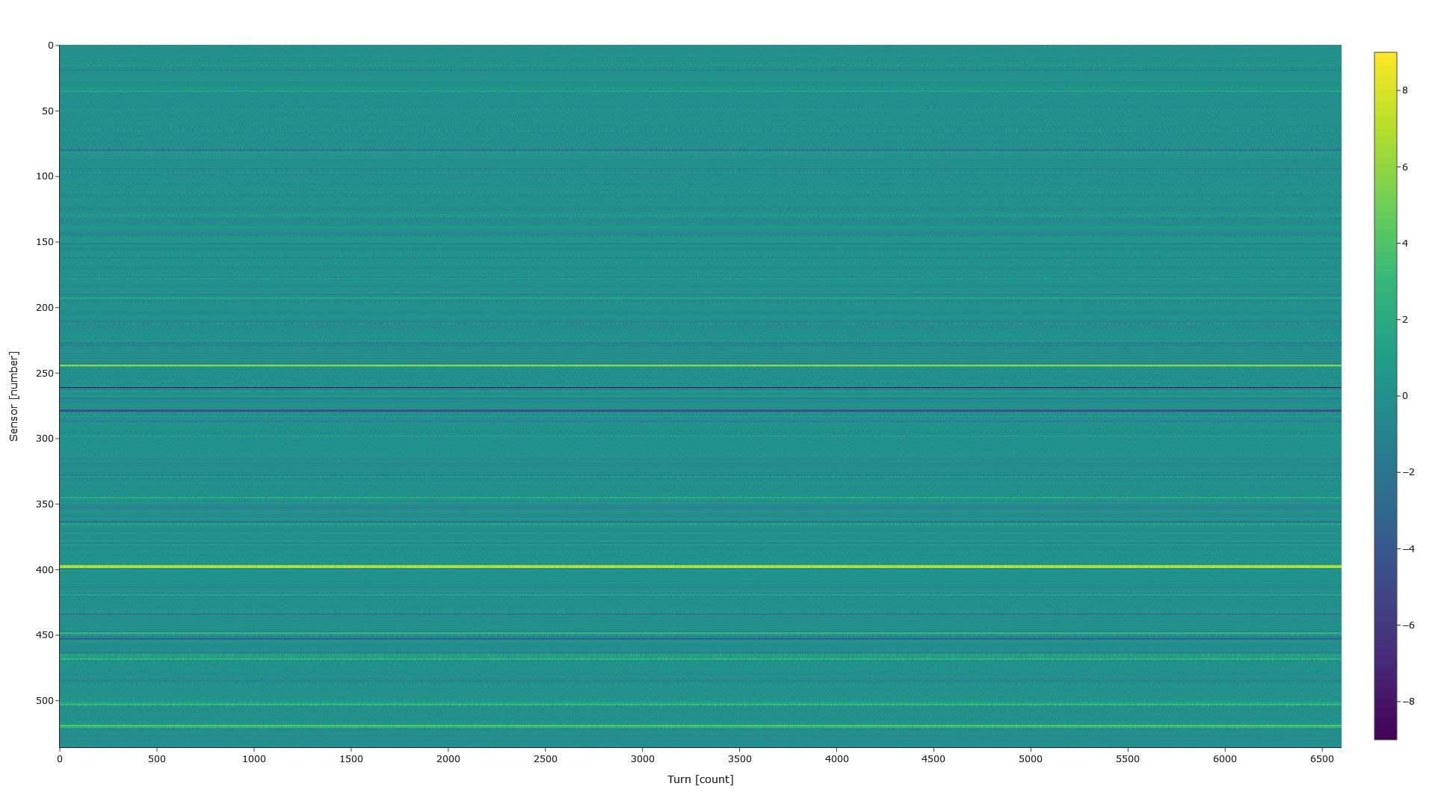
Heatmap [+/-9]: Beam1@Turn@2018_05_29@17_48_36_697Y

Slide 9
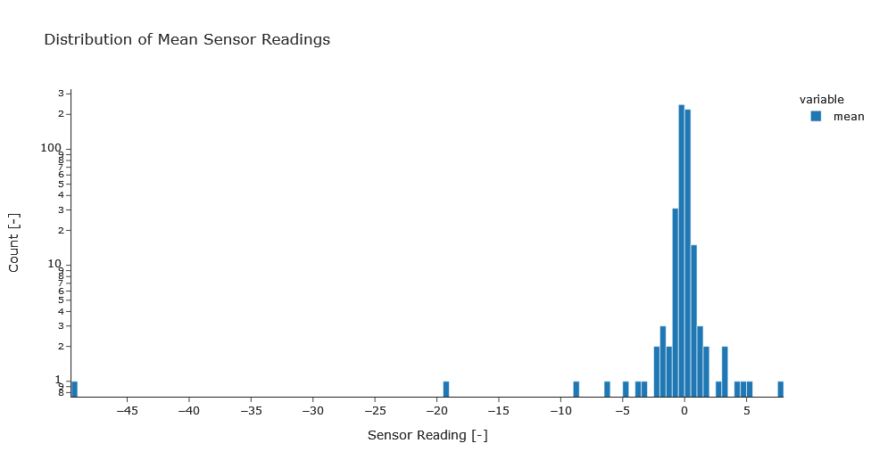
Distribution of mean sensor readings: Beam1@Turn@2018_05_29@17_48_36_697X

Slide 10
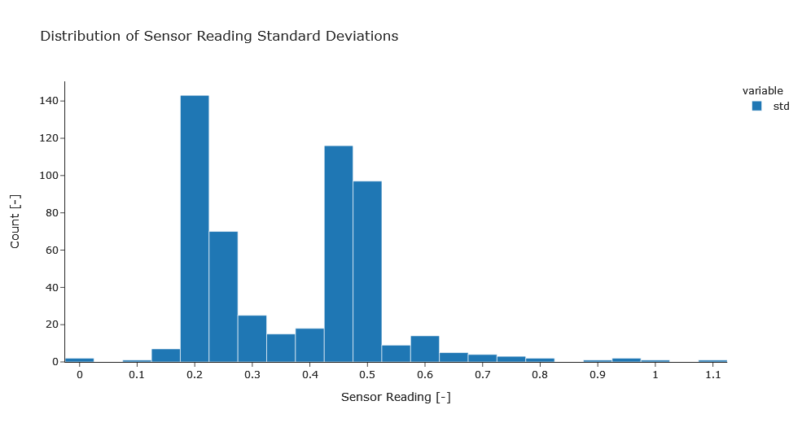
Distribution of Standard deviations: Beam1@Turn@2018_05_29@17_48_36_697X

Slide 11
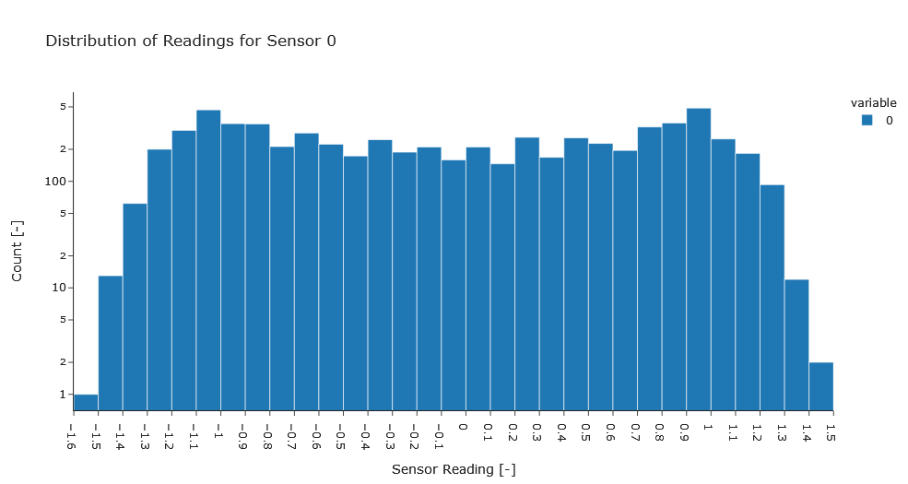
Distribution of readings for sensor 0: Beam1@Turn@2018_05_29@17_48_36_697X

Slide 12
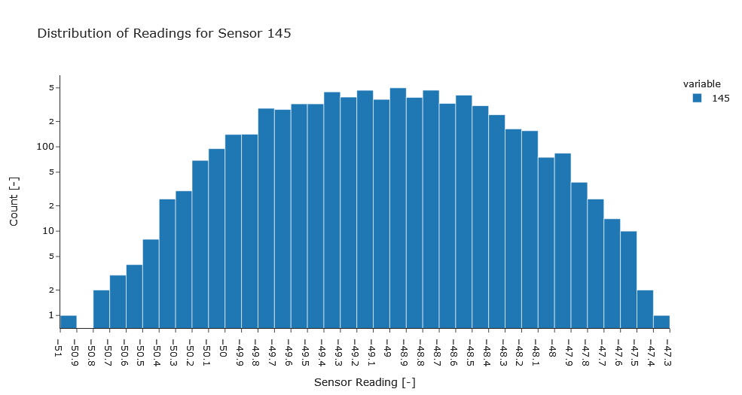
Distribution of readings for sensor 145: Beam1@Turn@2018_05_29@17_48_36_697X

Slide 13
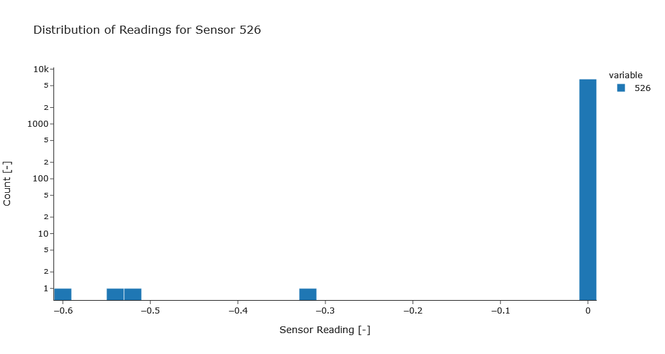
Distribution of readings for sensor 526: Beam1@Turn@2018_05_29@17_48_36_697X

Slide 14
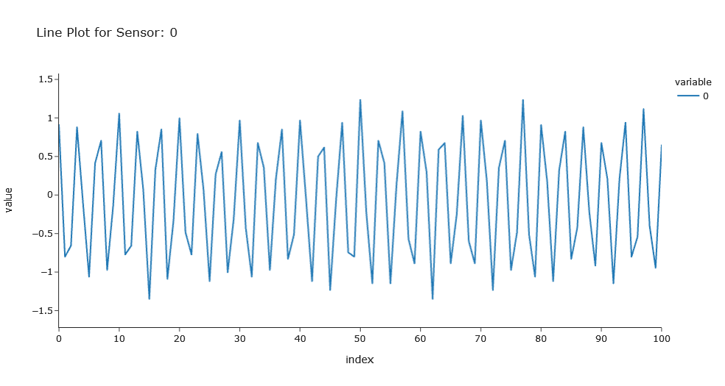
Line-plot of first 100 turns for sensor 0: Beam1@Turn@2018_05_29@17_48_36_697X

Slide 15
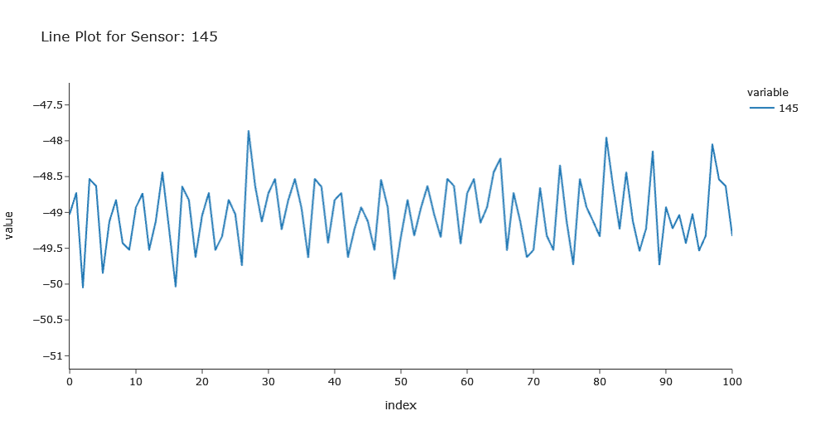
Line-plot of first 100 turns for sensor 145: Beam1@Turn@2018_05_29@17_48_36_697X

Slide 16
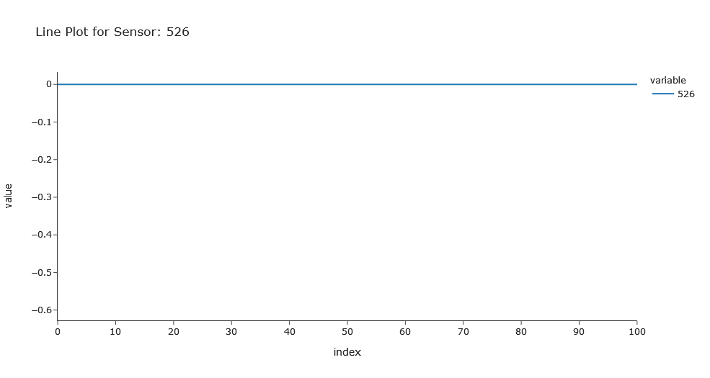
Line-plot of first 100 turns for sensor 526: Beam1@Turn@2018_05_29@17_48_36_697X

Slide 17
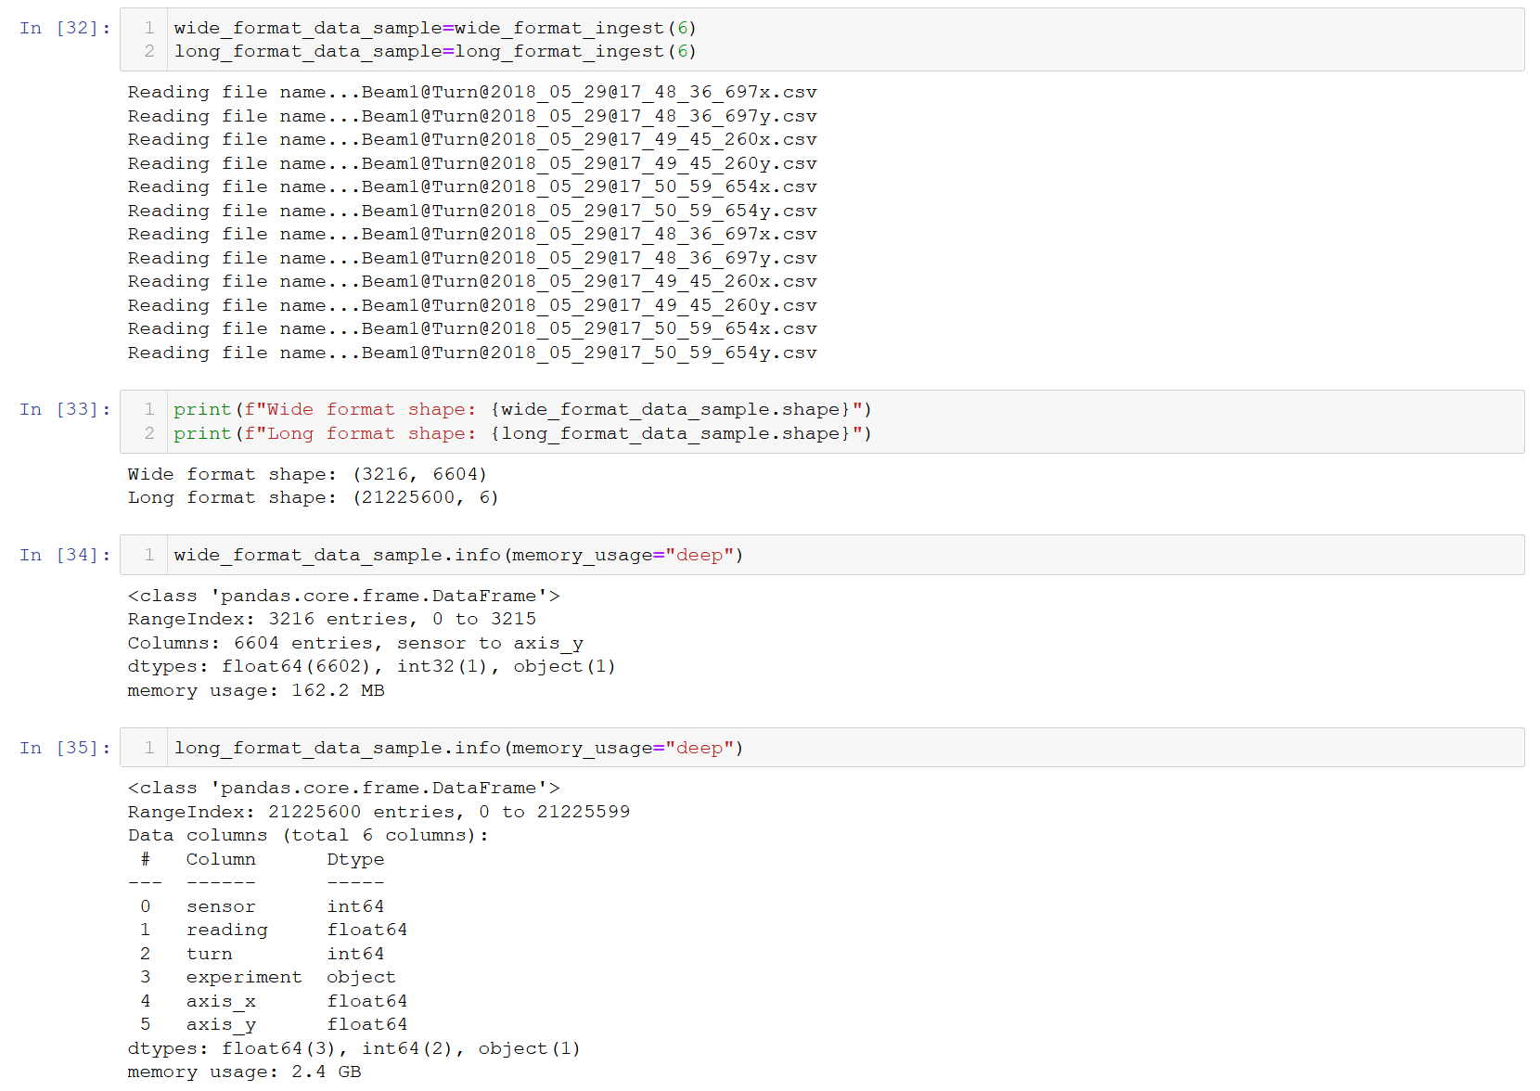
data efficiency experiment
Spark gains its speed by working on RDD’s that are held in memory, rather than having to read/write to disk.
This means that memory efficiency is crucial to performance.
A short experiment was run to understand if “wide” or “long” format would be more memory efficient.
It can be observed that wide format requires less than 7% of the memory that long format required.
Hence, wide format will be used for prototyping and in the final product.

Slide 18
2] Exploratory data analysis: clustering
CERN Beam Position Monitor Data

Slide 19
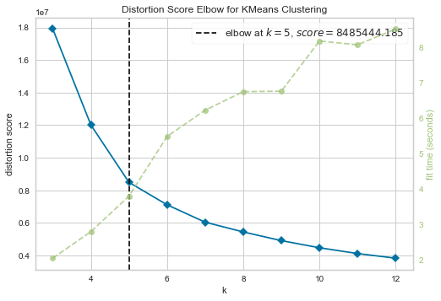
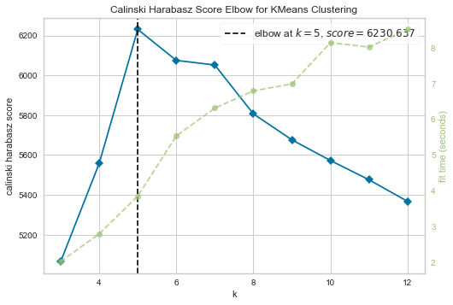
Elbow analysis in scikit learn
Optimum number of cluster number determined using elbow analysis, with two key metrics:
The distortion score is the sum of squared distances for each point to its cluster centre.
The Calinski-Harabasz score is a ratio of dispersion between and within clusters.
Both metrics point towards k=5 being the optimum number of clusters.

Slide 20
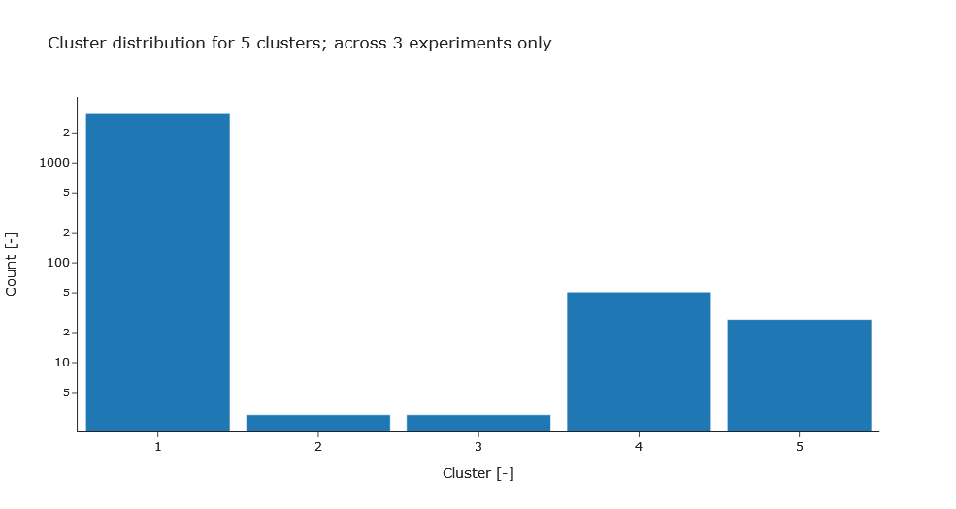
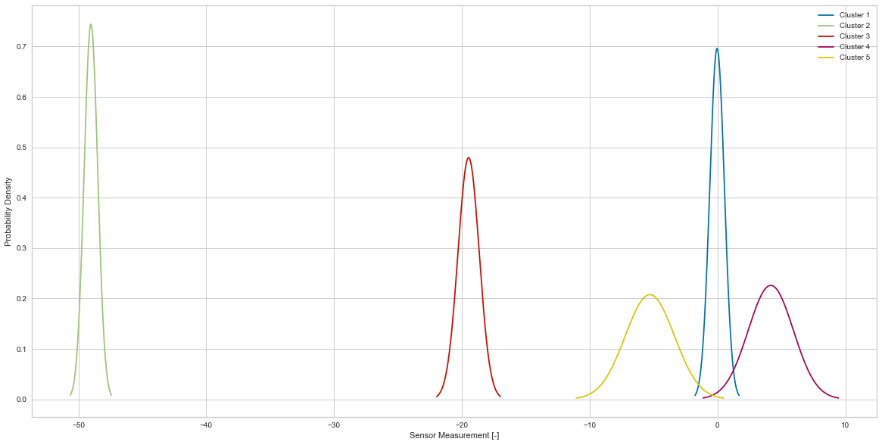
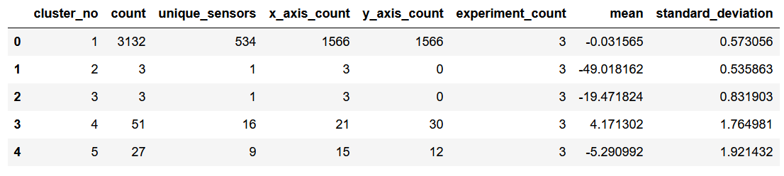
Analysis of recommendation

Slide 21
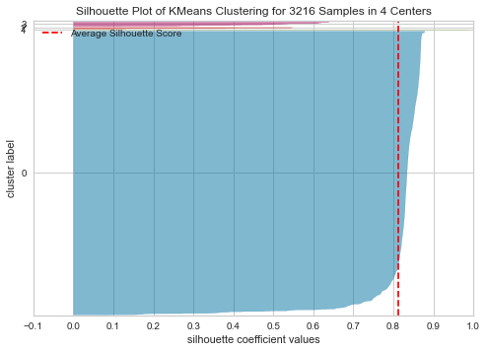
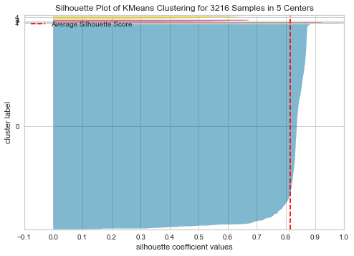
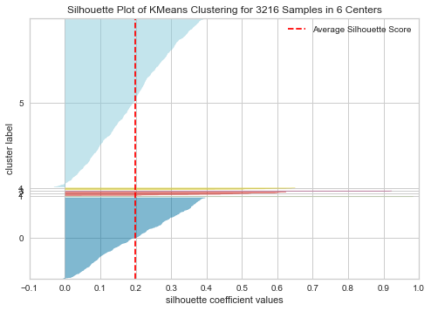
Silhouette analysis of clusters
The Silhouette Coefficient represents how similar a sample is to the other samples in the same cluster; with the mean being for all samples.
The average Silhouette score drops significantly moving from 5 to 6 clusters; hinting that two clusters are very close together with significant overlap – meaning a high volume of samples are well matched to multiple clusters.

Slide 22
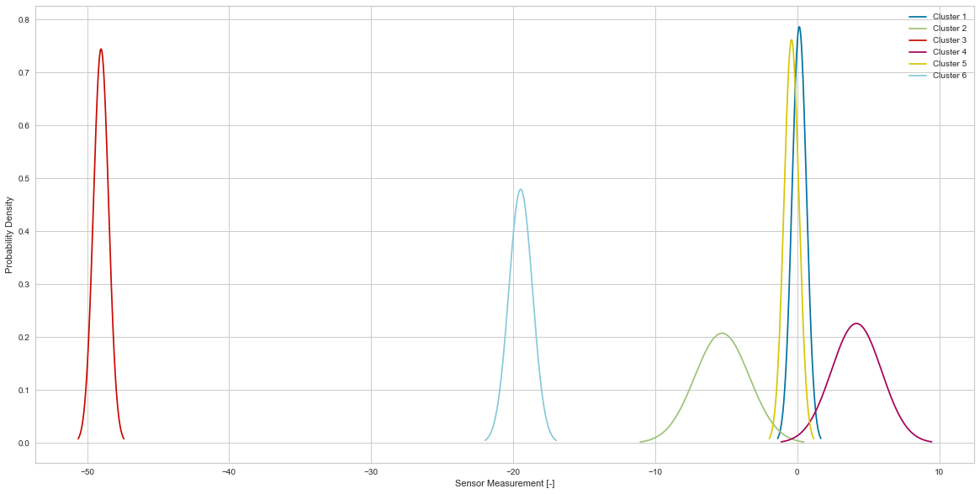
Analysis of recommendation
k=5
k=6
The primary observable change in moving from k=5 to k=6 is a splitting of the highest volume cluster; which is the node considered “normal observations”.
This is in-line with the Silhouette analysis; the largest cluster being split and having significant overlap.
It is clear from the elbow analysis and the additional analysis of the recommendation that a cluster number of k=5 should be used going forward.

Slide 23
3] Verify prototype
CERN Beam Position Monitor Data

Slide 24
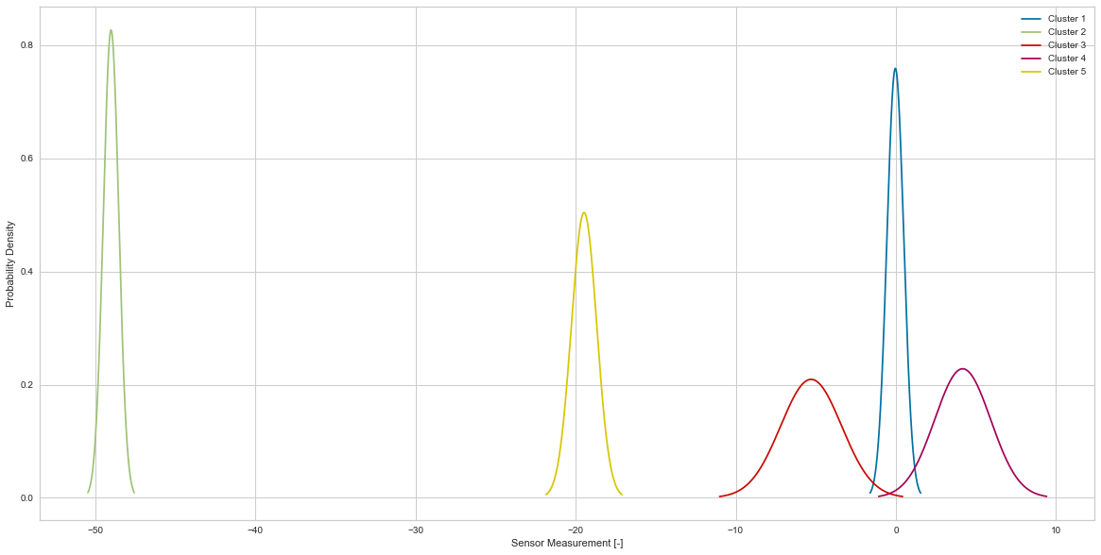
Distribution analysis of clusters
Increasing the proportion of the full dataset to 21% [14/66 files] does not seem to have impacted the performance of the algorithm and hyperparameter selection.

Slide 25
4] Big data solution
CERN Beam Position Monitor Data

Slide 26
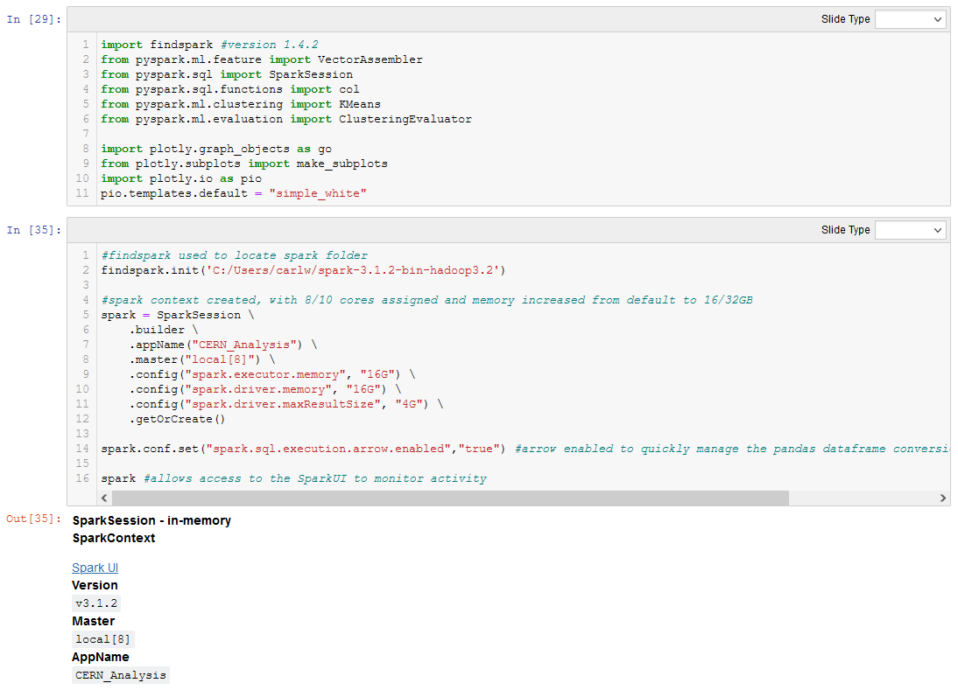
Big data solution: code
Pyspark was used to develop a distributed solution.
A total of 8 local cores [out of 10 physical] were assigned to the SparkSession.
A total of 16GB [out of 32GB] memory was also assigned in the configuration for executor and driver memory.
PyArrow [Apache] was also used to allow quick translate Pandas dataframes to Spark.

Slide 27
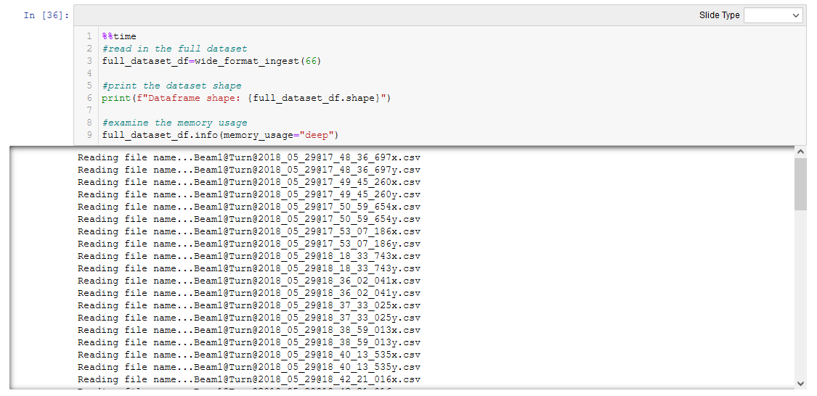
Big data solution: code
All 66 sample files were loaded into a single dataframe, sticking with the wide data format.
This took a total of 1.7GB of memory and created a dataframe of shape: 35376 x 6604.

Slide 28
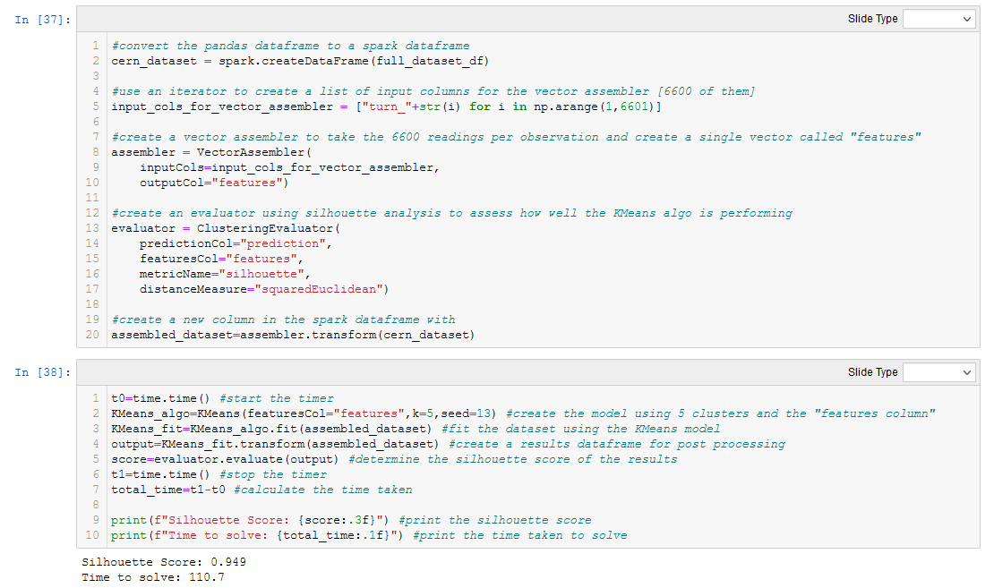
Big data solution: code
A list was created of the 6600 “turn” columns and passed to the assembler to create a single vector of input data.
Silhouette was selected for measuring the efficacy of the clusters.

Slide 29
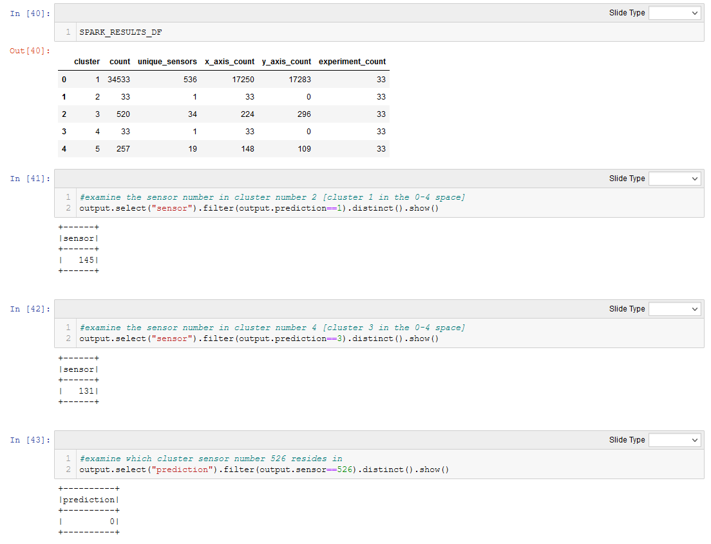
Big data solution: Results
The silhouette score for the entire dataset was 0.949; showing an improvement over the prototype.
The solve took only 111 seconds; relatively quick for processing over 233 million data points.
Clusters 2 and 4 had only 33 observations – indicating the algorithm is also cleanly identifying outlying sensors 131 and 145 in the x axis; both consistently reading low across all experiments.
There does not seem to be any bias between the two axes, with relatively even distributions of both axes in clusters 1, 3 and 5.
Each experiment is also represented in each cluster; indicating no bias between experiments.
One potential failing of the solution is with sensor 526, which had a low variation by turn, which is grouped in with cluster 1.

Slide 30
5] validation
CERN Beam Position Monitor Data

Slide 31
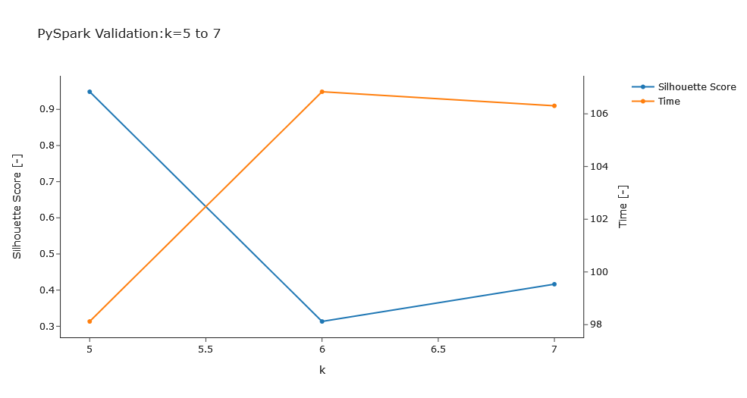
Validation: cluster number
Moving from k=5 to k=6 the Silhouette score drops significantly, from >0.9 to <0.4.
This also coincides with a jump up in solve time from ~98s to ~106s.
The Validation suggests the cluster number of 5 has scaled well to the full dataset.

